Slide 1
Étude paramétrique et optimisation d’un récepteur solaire à particules
F. ORDÓÑEZ
C. CALIOT
G. LAURIAT
F. BATAILLE

Slide 2
Summary
Context
Objectives
Physical model
Results
Conclusions and future works
2

Slide 3
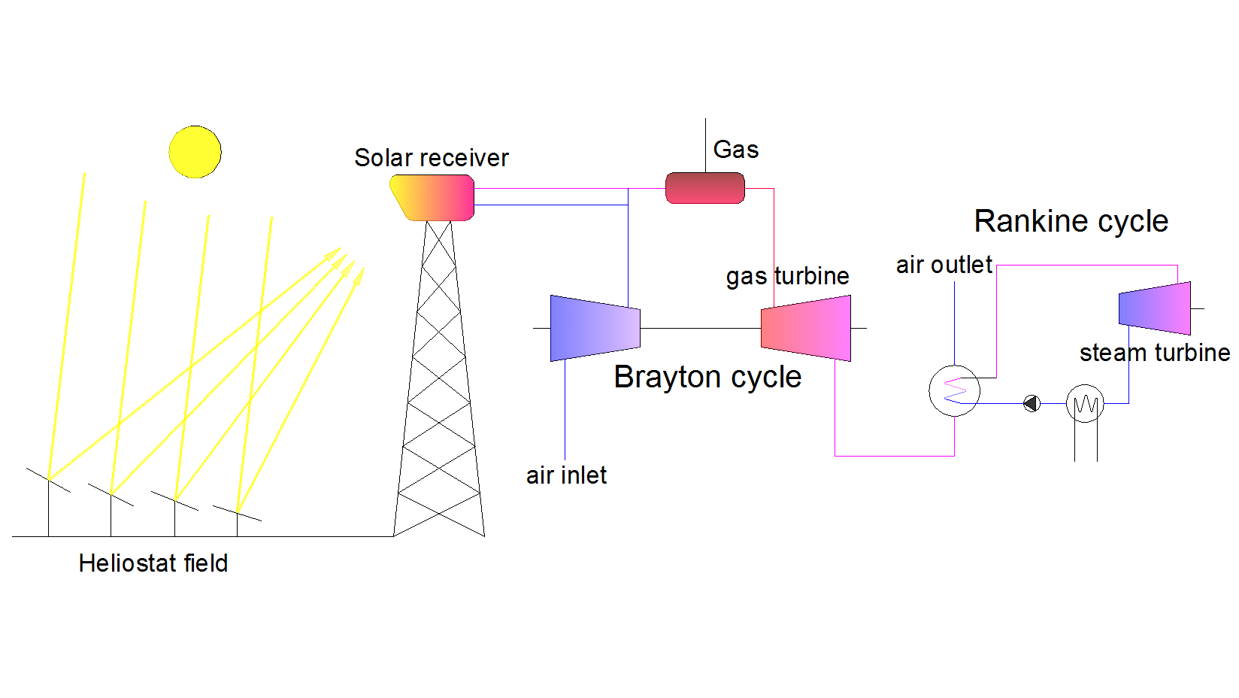
Solar Thermal Power Plants Gas Combined Cycle
Annual net efficiency 12-20 % > 50%
Source: Romero et al. 2000
Cost of energy production 129-206 $/MWh 74-102 $/MWh
Source: Lazard estimates 2009
Increasing the temperature of working fluid.
Increasing the cycle efficiency.
3
Notes:
1. Nowadays, the annual global efficiency of Solar Thermal Power Plants is lesser than 20% face to gas combined cycle efficiency which is around 50%

Slide 4
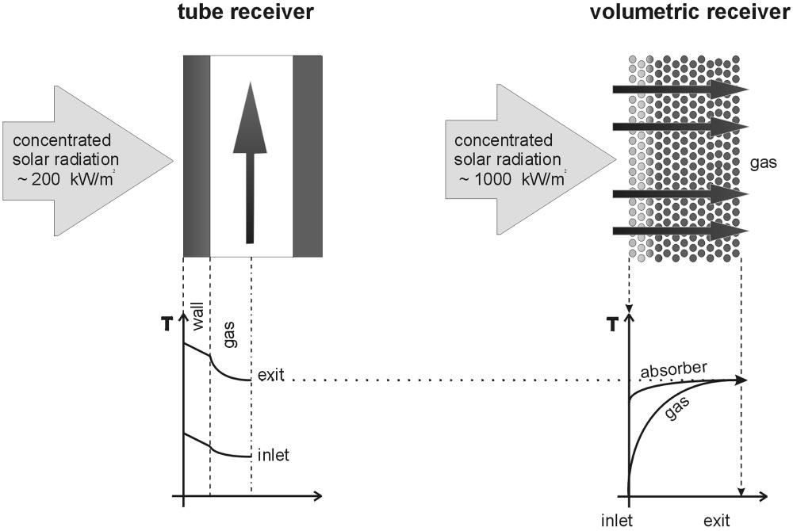
In tube receivers the solar radiation is absorbed in surface
In volumetric receiver the solar radiation is absorbed into the volume
Source: Romero et al. 2002
4

Slide 5
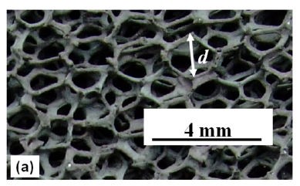
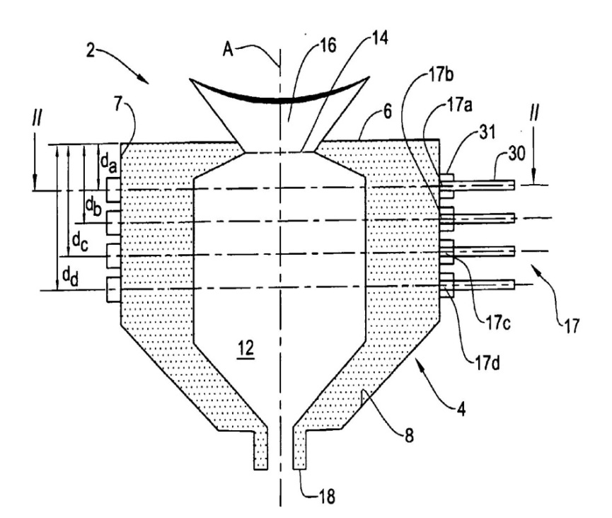
Two concepts of volumetric receivers exist
Porous receivers
Ceramic foam (SiC)
Source: Wu et al. 2011
Particles receivers
5
Source: Karni and Bertocchi 2005

Slide 6
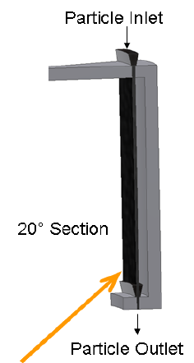
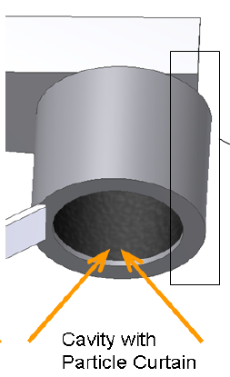
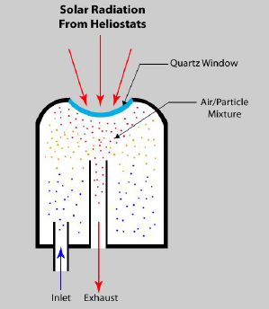
Volumetric receivers seeded by particles
Particles: sub-micron carbon particles
Particle radius recommended: 0,2 µm
Temperature reported: 1000 K
Theoretical efficiency: 90%
Source: Gobereit et al. 2012
Windowless atmospheric pressure receiver
Particles: sintered bauxite
Particle diameter: 0.7 mm
Theoretical efficiency: 89%
The particles serve themselves as storage medium
Source: Kitzmiller et al. 2012
6

Slide 7
Summary
Context
Objectives
Physical model
Results
Conclusions and future works
7

Slide 8
Objectives
Design and modeling of a solar particle receiver optimized
This study has two main objectives:
  To build a simplified model of a solar receiver seeded by particles
  To optimize the parameters that drive the efficiency of solar particle receiver
8
Notes:
6. There is not enough information about the optimal values of parameters that drive the solar particle receiver behavior which allow maximizing its efficiency.

Slide 9
Strategy
1 Parametric study for a single particle (n, k, r)
2 Parametric study for a slab of particles mono-disperses (n, k, r, f_{v})
3. Minimizing the Reflectance
4.1 Optimization of a slab of particles mono-disperses
4.2 Optimization of a slab of particles poly-disperses
9
Notes:
6. There is not enough information about the optimal values of parameters that drive the solar particle receiver behavior which allow maximizing its efficiency.

Slide 10
Summary
Context
Objectives
Physical model
Results
Conclusions and future works
10

Slide 11
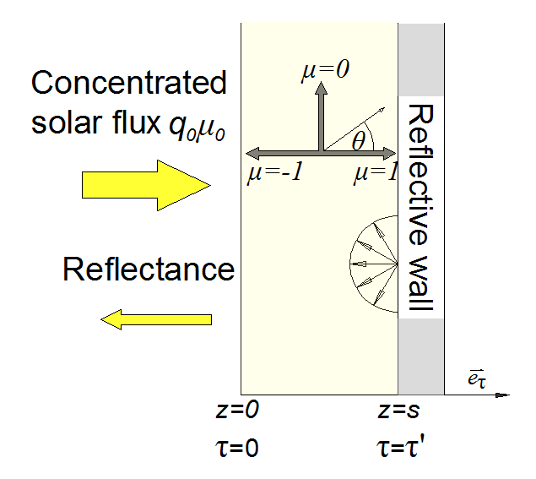

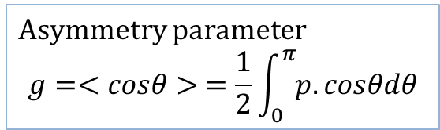
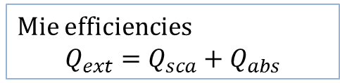
Model physique
A simplified model has been developed (mono-dimensional and single layered geometry, cold media, poly-dispersion of spherical particles)
Mie efficiencies
$${Q_{ext}=Q}_{sca}+Q_{abs}$$
$$R=\frac{q^{−}(0)}{q_{0}μ_{0}}$$
Asymmetry parameter
$$g=<cosθ> =\frac{1}{2}\int_{0}^{π}{p.cosθdθ}$$
The Lorenz-Mie theory has been used to found the radiative properties of particles (Mie efficiencies and asymmetry factor) and the Henyey-Greenstein phase function has been used to solve the angular behavior of scattering
11

Slide 12
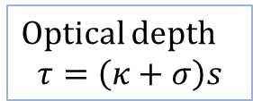

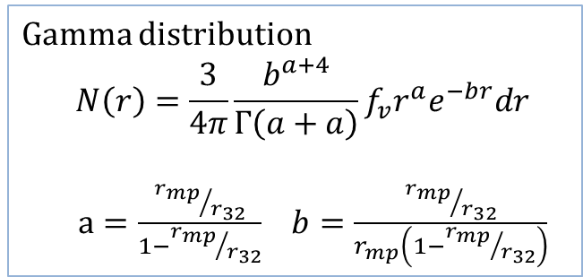



Model physique
A simplified model has been developed (mono-dimensional and single layered geometry, cold media, poly-dispersion of spherical particles)
Volumetric coefficients
$$κ=\int_{0}^{∞}{πr^{2}}Q_{abs}\left(r\right)N\left(r\right)dr$$
$$σ=\int_{0}^{∞}{πr^{2}}Q_{sca}\left(r\right)N\left(r\right)dr$$
$β=$ $κ+σ$
$$R=\frac{q^{−}(0)}{q_{0}μ_{0}}$$
Optical depth
$$τ=\left(κ+σ\right)s$$
$$r_{mp}$$
Gamma distribution
$$N\left(r\right)=\frac{3}{4π}\frac{b^{a+4}}{Γ\left(a+a\right)}f_{v}r^{a}e^{−br}dr$$
$a=\frac{{r_{mp}}/{r_{32}}}{1−{r_{mp}}/{r_{32}}}$ $b=\frac{{r_{mp}}/{r_{32}}}{r_{mp}\left(1−{r_{mp}}/{r_{32}}\right)}$
$$\frac{r_{mp}}{r_{32}}$$
12

Slide 13
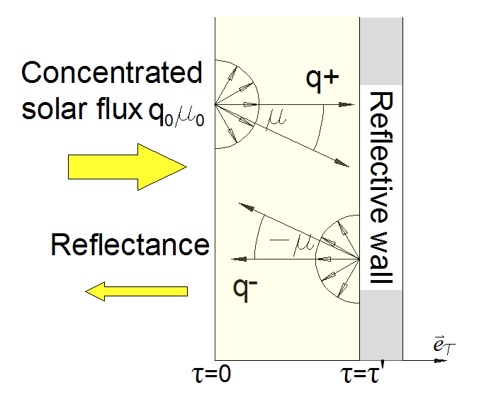
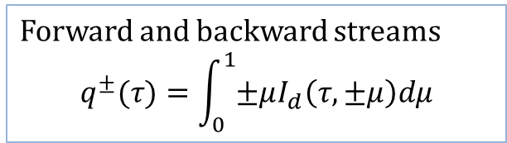
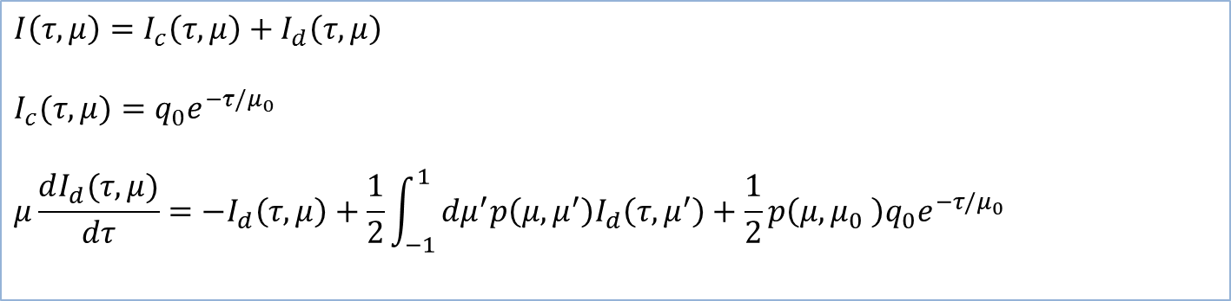
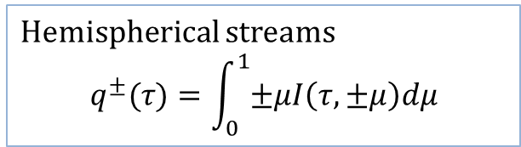
Model physique
A simplified model has been developed (mono-dimensional and single layered geometry, cold media, poly-dispersion of spherical particles)
The radiative transfer equation (RTE) has been solved with a two-stream approximation
$$R=\frac{q^{−}(0)}{q_{0}μ_{0}}$$
$$I\left(τ,μ\right)={I_{c}\left(τ,μ\right)+I}_{d}\left(τ,μ\right)$$
$$I_{c}(τ,μ)=q_{0}e^{−τ/μ_{0}}$$
$$μ\frac{dI_{d}(τ,μ)}{dτ}=−I_{d}\left(τ,μ\right)+\frac{1}{2}\int_{−1}^{1}{dμ^{′}p\left(μ,μ^{′}\right)I_{d}\left(τ,μ^{′}\right)+\frac{1}{2}}p\left(μ,μ_{0} \right)q_{0}e^{−τ/μ_{0}}$$
Forward and backward streams
$$q^{±}(τ)=\int_{0}^{1}{±μI_{d}\left(τ,±μ\right)dμ}$$
13

Slide 14

Model physique
A simplified model has been developed (mono-dimensional and single layered geometry, cold media, poly-dispersion of spherical particles)
A modified Eddington-delta function hybrid method has been used to approximate the intensity (I)
$$R=\frac{q^{−}(0)}{q_{0}μ_{0}}$$
$$I_{d}\left(τ,±μ\right)=\frac{1}{1−g^{2}(1−μ_{0})}\left\{\left(1−g^{2}\right)\left[\left(1±\frac{3μ}{2}\right)q^{+}+\left(1∓\frac{3μ}{2}\right)q^{−}\right]+g^{2}δ(μ−μ_{0})q^{±}\right\}$$
Intensity vs angle for a slab of particles mono-disperses at τ=2
m=2,7+0.8i
r=5 µm
τ₀= 4
14

Slide 15
Summary
Context
Objectives
Physical model
Results
  Parametric study
  Receiver optimization
Conclusions and future works
15

Slide 16
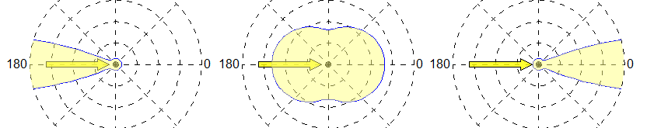
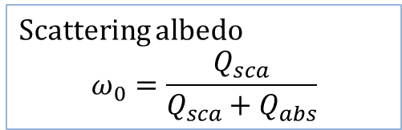
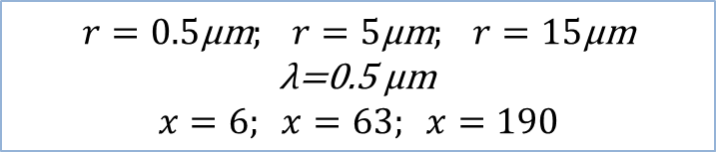
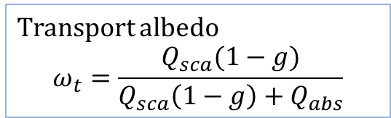
Parametric study for a single particle
Parameters
refractive index: m=n+ik
particle radius: r
$$r=0.5\text{µ}\text{m}; r=5\text{µ}\text{m}; r=15\text{µ}\text{m}$$
λ=0.5 µm
$$x=6; x=63; x=190$$
Scattering albedo
$$ω_{0}=\frac{Q_{sca}}{Q_{sca}+Q_{abs}}$$
Transport albedo
$$ω_{t}=\frac{Q_{sca}(1−g)}{Q_{sca}\left(1−g\right)+Q_{abs}}$$
g=-1 g=0 g=1
ω_{t} tends to one ω_{t} tends to zero
16

Slide 17
Parametric study for a single particle
ω_{t} vs k; n=2.27496 Q_{abs} vs k; n=2.27496
For k<0.01
x increases→ absorption increases →ω_{t} decreases
For 0.01<k<0.5
absorption increases → ω_{t} decreases
For k>0.5
absorption decreases → ω_{t} increases
17

Slide 18
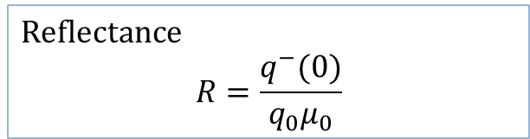
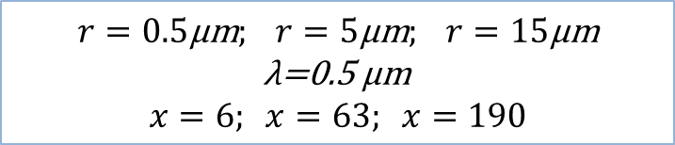
Parametric study for a slab of particles mono-disperses
Parameters
refractive index: m=n+ik
particle radius: r
volumetric fraction: f_{v}
$$r=0.5\text{µ}\text{m}; r=5\text{µ}\text{m}; r=15\text{µ}\text{m}$$
λ=0.5 µm
$$x=6; x=63; x=190$$
The Reflectance has been taken as the indicator of efficiency receiver
Reflectance
$$R=\frac{q^{−}(0)}{q_{0}μ_{0}}$$
18

Slide 19
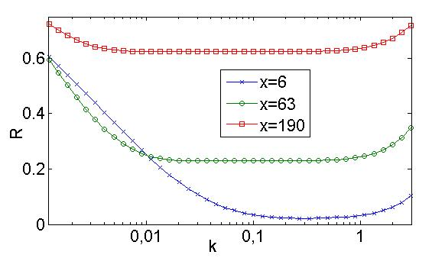
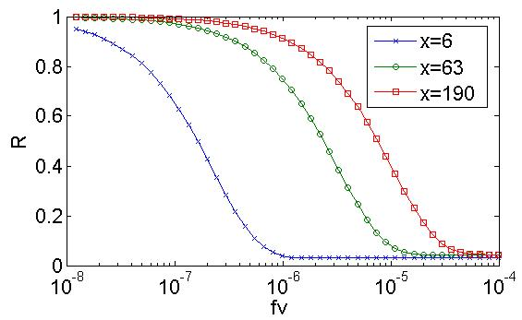
Parametric study for a slab of particles mono-disperses
R vs k (n=2.27496 and f_{v}=5e-6)
R vs f_{v} (n=2.27496 and k=0.87417)
For the same volume fraction, the slab of small particle contain more particles than the slab of large particles
For large particles one can minimizes the reflectance increasing the volume fraction
19

Slide 20
Summary
Context
Objectives
Physical model
Results
  Parametric study
  Receiver optimization
Conclusions and future works
20

Slide 21
Receiver optimization
A Particle Swarm Optimization (PSO) algorithm has been used to find the parameters that minimize the reflectance (R) for:
Slab of particles mono-disperses
Slab of particles poly-disperses
Parameters for slab of particles mono-disperses
refractive index: m=n+ik
particle radius: r
volumetric fraction: f_{v}
21

Slide 22


Receiver optimization
A Particle Swarm Optimization (PSO) algorithm has been used to find the parameters that minimize the reflectance (R) for:
Slab of particles mono-disperses
Slab of particles poly-disperses
Parameters for slab of particles poly-disperses
refractive index: m=n+ik
most probable radius: r_{mp}
width parameter: r_{mp}/r₃₂
volumetric fraction: f_{v}
$$r_{mp}$$
$$\frac{r_{mp}}{r_{32}}$$
22

Slide 23
Receiver optimization
Slab of particles mono-disperses
Slab of particles poly-disperses
2,7.10⁻³
2,9.10⁻³
2,8.10⁻³
2,9.10⁻³
4,6
50
4,5
0,9
50
0,9
1,5
0,04
1,5
0,006
1,5
0,04
1,5
0,006
2,3.10⁻⁵
2,6.10⁻⁴
0,95
0,53
8
2,5.10⁻⁵
2,9.10⁻⁴
0,95
0,55
8
0,95
0,54
8
0,95
0,55
8
23

Slide 24
Summary
Context
Objectives
Physical model
Results
Conclusions and future works
24

Slide 25
Conclusions
A solar particle receiver was modeled as an absorbing, anisotropic scattering and cold media slab of particles (mono and poly disperses)
An optimization of a solar particle receiver was done with the help of a PSO algorithm
25

Slide 26
Future works
1/ Improvement of the model for a slab of particles with absorption, scattering and emission.
2/ Development of a multi-slab model.
3/ Optimization of this new model with the PSO algorithm developed.
4/ Study of coupling of heat transfer between radiation and convection in a solar particle receiver optimized.
26

Slide 27
Thanks for your attention

Slide 28
Parametric study for a slab of particles
Radiative fluxes: collimated, forward diffuse and backward diffuse for two different optical ticknesses τ₀ = 4 and τ₀ = 8 (n=1.5, k=0,0425 and r=4.63 µm)
q₀/q₀e^{-τ/µ0}
q+/q₀(τ₀= 4)
q-/q₀(τ₀= 4)
q₀/q₀e^{-τ/µ0}
q+/q₀(τ₀= 8)
q-/q₀(τ₀= 8)
For these conditions the asymptotic reflectance is reached when the optical thicknesses is 8

